Slide 1
Windows Azure IaaS to run SAP Business Suite and SAP HANA
Microsoft Asia
Datacenter/Platform Modernization
Takayuki Hoshino

Slide 2
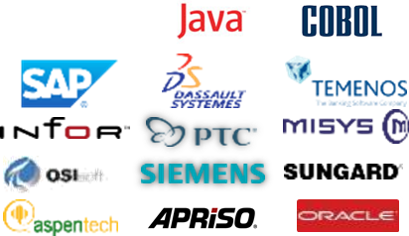




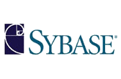

CHALLENGES WITH BUSINESS APPLICATIONS
Performance ?
User Experience ?
System performance poor and slowdown takes place often
due to slow CPUs, small memory and poor I/O
Information workers
quite stressed out
with unproductive
user experience
OS390/zOS
Availability ?
Total Costs ?
System recovery process doesn’t really exist and risks cannot be calculated
TCO remains high on legacy platforms without agility nor flexibility

Slide 3
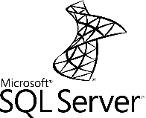






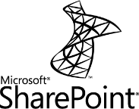

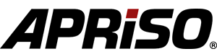


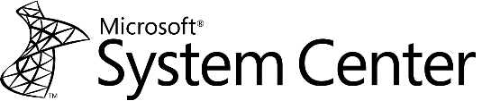


TIER-1 APP MODERNIZATION ON THE CLOUD
Tier-1 Applications
Business Users, Information Workers
Rehost/Rewrite
Surround
OS390/zOS
Partner Cloud

Slide 4

5 GOALS OF MODERNIZATION
In-memory
Real-time Performance
Maximized
User
Productivity
Sky-high
Availability
Total Costs
Fully Managed
Migration Risks
Mitigated

Slide 5





















Modernization of SAP Platform and User Experience
iPhone, iPad, Android
BPM & Workfow
BI & Analytics
Enterprise Integration
SAP NetWeaver Gateway
Active Directory
Authentication
OS/DB Platform, Private/Public Cloud
IT Automation

Slide 6

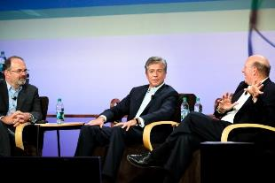

SAP and Microsoft – Global Alliance
SAP is one of WW top resellers of SQL Server Enterprise
Duet Enterprise jointly released by SAP and Microsoft
SAP and Microsoft driving partner program together
Over 20-year global technology alliance relationship since 1993
Development team and support team stationed in each other’s office
Integrations fully committed in the private/public cloud space
SAP and Microsoft are a user of each other’s product suite
Microsoft is one of world’s heaviest SAP users
SAP is one of strategic global accounts at Microsoft –fully standardized with Microsoft Business Productivity Suite
Go To Market
Technology Partner
Customer
6

Slide 7










Modernizing SAP Platform on Microsoft Cloud OS (Hyper-V and Azure)
All SAP Business Suite applications are fully “multi-platform”
SAP system copy is export and import - no difference at all whatever OS/DB platform you migrate to
SAP has a standard tool kit for heterogeneous system copy (OS/DB change)
System Center 2012
SAP on UNIX
and Oracle
Export
Import
SAP on Windows Server 2012
SQL Server 2012
on Hyper-V (Private Cloud)
AND | OR
SAP on UNIX/OS390/
AS400 and DB2
OS/DB independent Dump files
generated
SAP on Windows Server 2012
SQL Server 2012
on Azure VM (Public Cloud)
SAP on Windows Server
and SQL Server

Slide 8



SAP on Windows Azure Current Status
SAP’s official certification for Windows Azure IaaS/VM coming soon
SAP Business Suite, Netweaver 7.x in production
  ERP / HCM / CRM / SCM / SRM / BW / Portal / XI/PI / NetWeaver / Solution Manager
  Including Business All-in-One, Rapid Deployment Solutions
  Supported OS/DB : Windows 2008 R2/2012/2012 R2, SQL Server 2008 R2/2012/2014 or Sybase ASE
  (*) Other OS/DBs to follow (no timeframe yet)
SAP HANA One and HANA Developer Edition
  Supported OS : Suse Linux Enterprise Server 11 or later
SD Benchmark on Windows Azure
  A5 = 1,500 SAPS, A6 = 3,000 SAPS, A7 = 6,000 SAPS
  Over 50,000 SAPS is configurable by having multiple AP servers
(*) SAP Afaria, Mobile Platform, Sybase IQ, Sybase ASE to follow
(*) SAP Business Analytics (BO, EIM, Crystal) on Win/SQL/Linux/ASE, SAP Business Suite/BW on Hana/Linux/ASE,
SybaseASE/Sybase IQ/NetWeaver on Linux, HANA One Premium on Linux, NetWeaver on HANA/Linux/ASE/MaxDB
Microsoft Confidential

Slide 9






Azure VM Instances for SAP Environment
Supported OS : Windows Server 2008 R2 / 2012 / 2012 R2 (Preview)
Supported DB : SQL Server 2008 R2 / 2012 / 2014 (Preview), Sybase ASE
Multiple AP servers (with a single DB server) is configurable
Size A5
Size A6
Size A7
# of cores | 2 core
memory | 14 GB
Network bandwidth | 200 Mbps
Local disk (PaaS) | 489 GB
Local disk C:(IaaS) | 126 GB
Local temp disk D:（IaaS) | 135 GB
IaaS Attach disks # | 4
Max IOPS (IaaS) | 2,000 (4 x 500)
SAPS | 1,500
Cost | $0.4/hour
# of cores | 4 core
memory | 26 GB
Network bandwidth | 1,000Mbps
Local disk (PaaS) | 999 GB
Local disk C:(IaaS) | 126 GB
Local temp disk D:（IaaS) | 285 GB
IaaS Attach disks # | 8
Max IOPS (IaaS) | 4,000 (8 x 500)
SAPS | 3,000
Cost | $0.8/hour
# of cores | 8core
memory | 52 GB
Network bandwidth | 2,000Mbps
Local disk (PaaS) | 2,039 GB
Local disk C:(IaaS) | 126 GB
Local temp disk D:（IaaS) | 605 GB
IaaS Attach disks # | 16
Max IOPS (IaaS) | 8000 (16 x 500)
SAPS | 6,000
Cost | $1.6$/hour
2 core
4 core
8 core
14 GB
26 GB
52 GB

Slide 10




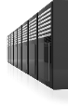



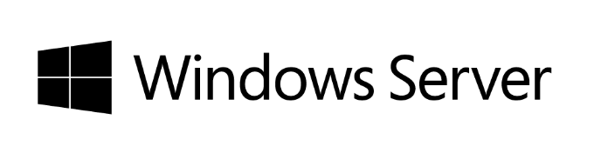

Windows Azure VM/IaaS to run SAP Business Suite, NetWeaver and HANA
Development
and Test
Disaster recovery
Production
Hyper-V

Slide 11
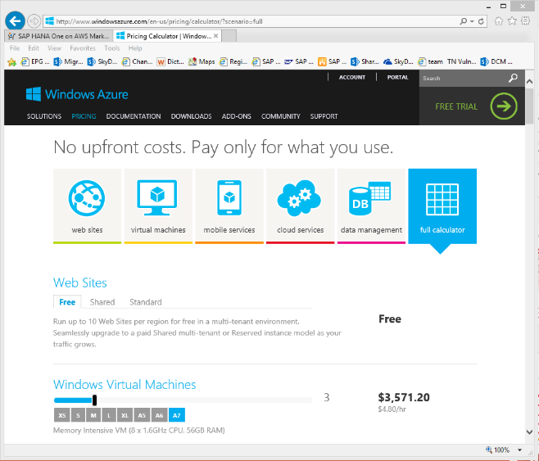
Windows Azure Pricing Calculator – Full Calculator
http://www.windowsazure.com/en-us/pricing/calculator/?scenario=full

Slide 12
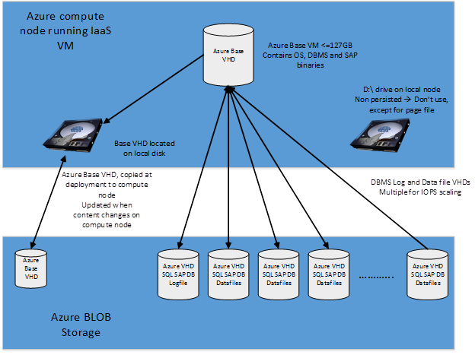
Basic Deployment structure
Principle of a 2-tier SAP or SAP DBMS VM

Slide 13

SAP and Sub System Migration to Azure
Customer’s datacenter
4
Sub systems
Sub system
migration to Azure
Sub systems
Interoperability
with sub systems
3
1
System
Copy
VPN
VHD
VHD
VHD
VHD
SAP ECC 6.0 on
Windows Server 2012
SQL Server 2012
SAP ECC 6.0 on
Windows Server 2008
Oracle Database
SAP ECC 6.0 on
Windows Server 2012
SQL Server 2012
on Hyper-V (On-premises)
VHD file
Upload
2

Slide 14







1. Deployment of Dev, Test and DR (Non-Production)
Windows Azure
SAP Transport
(from Dev to Test)
ERP Disaster recovery backup (AP+DB)
ERP Disaster recovery backup (AP)
ERP Development
ERP Test
Solution Manager
HANA Developer Edition
A6 (4 core / 26GB RAM)
A6 (4 core / 26GB RAM)
A5 (2 core/ 14GB RAM)
A6 (4 core / 26GB RAM)
A6 (4 core / 26GB RAM)
A6 (4 core / 26GB RAM)
SQL Server
SAP
SQL Server
SAP
SQL Server
SAP
SQL Server
SAP
SQL Server
SAP HANA
400 GB
(DB 300 GB)
100 GB
100 GB
400 GB
(DB 300 GB)
100 GB
200 GB
(DB 100 GB)
1.3 TB
SAP Transport
(from Dev to Prod)
backup
SQL Server
AlwaysOn
replica
VPN
System Center
On-premises
ERP Production DB+AP
StorSimple
ERP Production
DB+AP
ERP Production AP
ERP Production AP
monitoring
directory services
EDI
SAP
SQL Server
Sync
replica
SAP
SQL Server
SAP
SAP
System Center
Windows Server
Windows Server
400 GB
(DB 300 GB)
400 GB
(DB 300 GB)
100 GB
100 GB
200 GB
100 GB
200 GB

Slide 15


1. Deployment of Dev, Test and DR (Non-Production)
Simulated costs
# | Item | # of units | Unit price | Amount
1 | Azure A6 instance (Windows Server usage right included) | 5 VM 240 hours/month | $595.20/Month*¹ | $960/Month*²
2 | Azure A5 instance (Windows Server usage right included) | 1 VM 240 hours/month | $297.60/Month*¹ | $96/Month*²
3 | Azure virtual disk (Geo Redundant, backup included) | 2.6 TB | $0.1/GB/Month | $266/Month
4 | Azure data transfer+ VPN | 3TB/Month | $0.166 /GB | $510/Month
Sum |  |  |  | $1,832/Month
*¹ Unit price when running a VM all the time for one month
*² Amount running 240 hours in average for one month
Support services for Azure to be quoted separately.
ISV Royalty SQL Server runtime licenses through SAP or commercial licenses of SQL Server Enterprise through MS resellers can be used to run on Azure (license mobility).
15

Slide 16


2. Deployment of Production and Non-production
Windows Azure
Adding AP servers in production
only when needed (e.g. while running heavy batch programs)
2.2 TB
ERP Production DB+AP
ERP Production AP
ERP Production AP
BW Production DB+AP
HANA
A7 (8 core / 56 GB RAM)
A7 (8 core / 56 GB RAM)
A7 (8 core / 56 GB RAM)
A7 (8 core / 56 GB RAM)
A7 (8 core / 56 GB RAM)
backup
SAP ERP
SQL Server
SAP BW
SQL Server
SAP ERP
SAP ERP
SAP HANA
400 GB
(DB 300 GB)
400 GB
(DB 300 GB)
400 GB
(DB 300 GB)
100 GB
100 GB
100 GB
SQL Server
AlwaysOn
replica
ERP Production DB+AP
monitoring
directory services
ERP Development
ERP Test
Solution Manager
A6 (4 core / 26GB RAM)
A6 (4 core / 26GB RAM)
A6 (4 core / 26GB RAM)
A6 (4 core / 26GB RAM)
A6 (4 core / 26GB RAM)
A6 (4 core / 26GB RAM)
SAP ERP
SQL Server
System Center
Windows Server
SAP ERP
SQL Server
SAP ERP
SQL Server
SAP Solman
SQL Server
400 GB
(DB 300 GB)
100 GB
100 GB
100 GB
400 GB
(DB 300 GB)
100 GB

Slide 17

2-1. Deployment of Production and Non-production
Simulated costs
# | Item | # of units | Unit price | Amount
1 | Azure A7 instance (Windows Server usage right included) | 5 VM 480 hours/month | $1,190.40/Month*¹ | $3,839.4/Month*²
2 | Azure A6 instance (Windows Server usage right included) | 6 VM 480 hours/month | $595.20/Month*¹ | $2,304.0/Month*²
3 | Azure A5 instance (Windows Server usage right included) | 0 VM 480 hours/month | $297.60/Month*¹ | -
4 | Azure virtual disk (Geo Redundant, backup included) | 4.1 TB | $0.1/GB/Month | $419.8/Month
5 | Azure data transfer+ VPN | 3TB/Month | $0.166 /GB | $510.0/Month
Sum |  |  |  | $7,073.2/Month
*¹ Unit price when running a VM all the time for one month
*² Amount running 480 hours in average for one month
Support services for Azure to be quoted separately.
ISV Royalty SQL Server runtime licenses through SAP or commercial licenses of SQL Server Enterprise through MS resellers can be used to run on Azure (license mobility).
17

Slide 18
2-2. Deployment of Production and Non-production (Running 24x365)
Simulated costs
# | Item | # of units | Unit price | Amount
1 | Azure A7 instance (Windows Server usage right included) | 5 VM 744 hours/month | $1,190.40/Month*¹ | $5,952.0/Month*²
2 | Azure A6 instance (Windows Server usage right included) | 6 VM 744 hours/month | $595.20/Month*¹ | $3,571.2/Month*²
3 | Azure A5 instance (Windows Server usage right included) | 0 VM 744 hours/month | $297.60/Month*¹ | -
4 | Azure virtual disk (Geo Redundant, backup included) | 4.1 TB | $0.1/GB/Month | $419.8/Month
5 | Azure data transfer+ VPN | 3TB/Month | $0.166 /GB | $510.0/Month
Sum |  |  |  | $10,453.0/Month
*¹ Unit price when running a VM all the time for one month
Support services for Azure to be quoted separately.
ISV Royalty SQL Server runtime licenses through SAP or commercial licenses of SQL Server Enterprise through MS resellers can be used to run on Azure (license mobility).
18

Slide 19
Other considerations
Performance:
  Azure VMs of the sizes we will support with SAP will run alone on a host → no problem with CPU or memory resources
  Network infrastructure is shared and hence needs to get regulated by quotas
  Storage traffic goes through network and hence falls under quotas as well
  Storage nodes are used by many VHDs – whereas a single VHD can be striped over several Storage nodes
  Typical 8K random read latency (majority of SQL Server I/Os under SAP ERP workload) usually experiences 18ms latency

Slide 20
Other considerations
High Availability and Disaster Recovery
  Not possible to define windows Clusters with shared disks → No HA for SAP CI/ASCS/SCS
  VHDs on Azure Storage nodes are replicated twice – one replica in same Datacenter, another one geo-replicated to another DC in same region
    Geo-replication not valid for DBMS scenario where data and Tlog files are distributed on more than one VHD (no synchronization between replication of different VHDs mounted to one VM
  SQL Server Protection via AlwaysOn, even using Listener (Windows Cluster w/o shared disk is possible on Azure IaaS) – only works within one DC
  SQL Server Database Mirroring possible within one DC
  SQL Server Logshipping works within one DC
  Geo-Replication with SQL Server only would work with alternative Log-shipping

Slide 21


Simplifying SAP Infrastructure and Support Model
SAP
App
SAP
??
Database
Microsoft
Tons of
patterns and practices
to run SAP applications available in market
??
OS
Microsoft
??
Monitoring, backup,
Scheduler and security
Microsoft
??
Virtual Machine
Microsoft
Microsoft
(Azure)
Successful deployment
guaranteed
??
Server
Any
??
Storage
Any
??
Network
Any
Legacy & Complicated
Modernized & Simplified

Slide 22









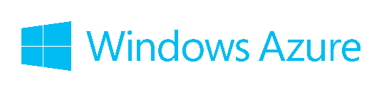
Integrated Management Between Private Cloud and Public Cloud
System Center 2012 R2
Private Cloud
Public Cloud
monitoring
Error/warning detection
Performance
Management
Create/Deploy/Boot/Shutdown/
Delete/Increase/Decrease
VHD file exchange
VM backup
Data backup
Hyper-V
VPN/https

Slide 23







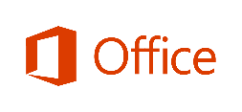






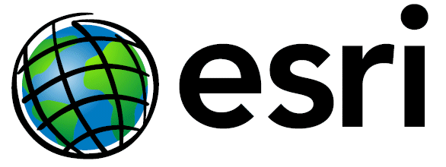



















MODERNIZED APPLICATION PLATFORM @ Manufacturing and Resources
Surface
Business Intelligence
Packaged Applications/Services
Custom Applications/Services
Hyper-V
Hyper-V
Intel Xeon CPU
Large memory /
memory storage
Virtualization and
Cloud
DB Compression
& Column-store
Automatic
DB Engine
Always On HA+DR
Hyper-V
Partner Ecosystem : Backup/Monitoring/Scheduling(Backup Exec, NetIQ, ArcServe..), Storage (EMC, HP, IBM, Hitachi, NetApp ..)

Slide 24
Temenos - T24
  http://www.microsoft.com/en-us/news/press/2011/jul11/07-13microfinancepr.aspx
Misys
  http://blogs.msdn.com/b/windowsazure/archive/2010/11/04/global-alliance-with-misys-extends-financial-services-applications-to-the-cloud.aspx
Infor - Infor24
  http://www.infor.com/company/news/pressroom/pressreleases/infor24/
PTC - Windchill
  http://www.terraxml.com/community/blog/bid/289782/Deploying-PTC-Windchill-on-the-Cloud
ESRI - ArcGIS
  http://www.esri.com/news/releases/11-1qtr/azure-marketplace.html
OSISoft
  http://channel9.msdn.com/Series/Cloud-Cover-Shorts/Episode-3-OSISoft
Siemens - PLM Team Center
  http://www.onwindows.com/Articles/Siemens-leads-the-way-with-cloud-PLM/5081/Default.aspx
Opentext
  http://bps.opentext.com/news-events/detail/opentext-brings-business-process-solutions-to-windows-azure/
Microfocus – Visual Cobol, Enterprise COBOL server
  http://www.microfocus.com/products/enterprise/enterprise-server-for-azure.aspx
GTSoftware | Fujitsu – NetCobol
  http://www.netcobol.com/solution/cobol-in-the-cloud/
Oracle – Oracle Database, WebLogic Server
  http://www.oracle.com/technetwork/topics/cloud/faq-1963009.html

Slide 25







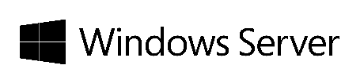
Operation Manager, Virtual Machine Manger, Orchestrator, AppController,
Configuration Manager, Forefront Endpoint

Slide 26





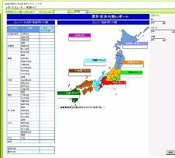
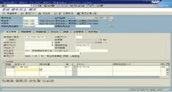



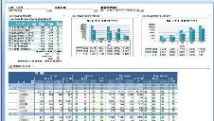


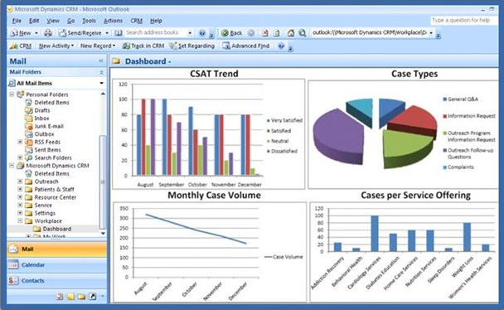

ISID BUSINESS SPECTRE VNEXT
SAP ERP
Data Mart
SAP Data
ETL
Cube
Customer data
Product data
Order history

Slide 27
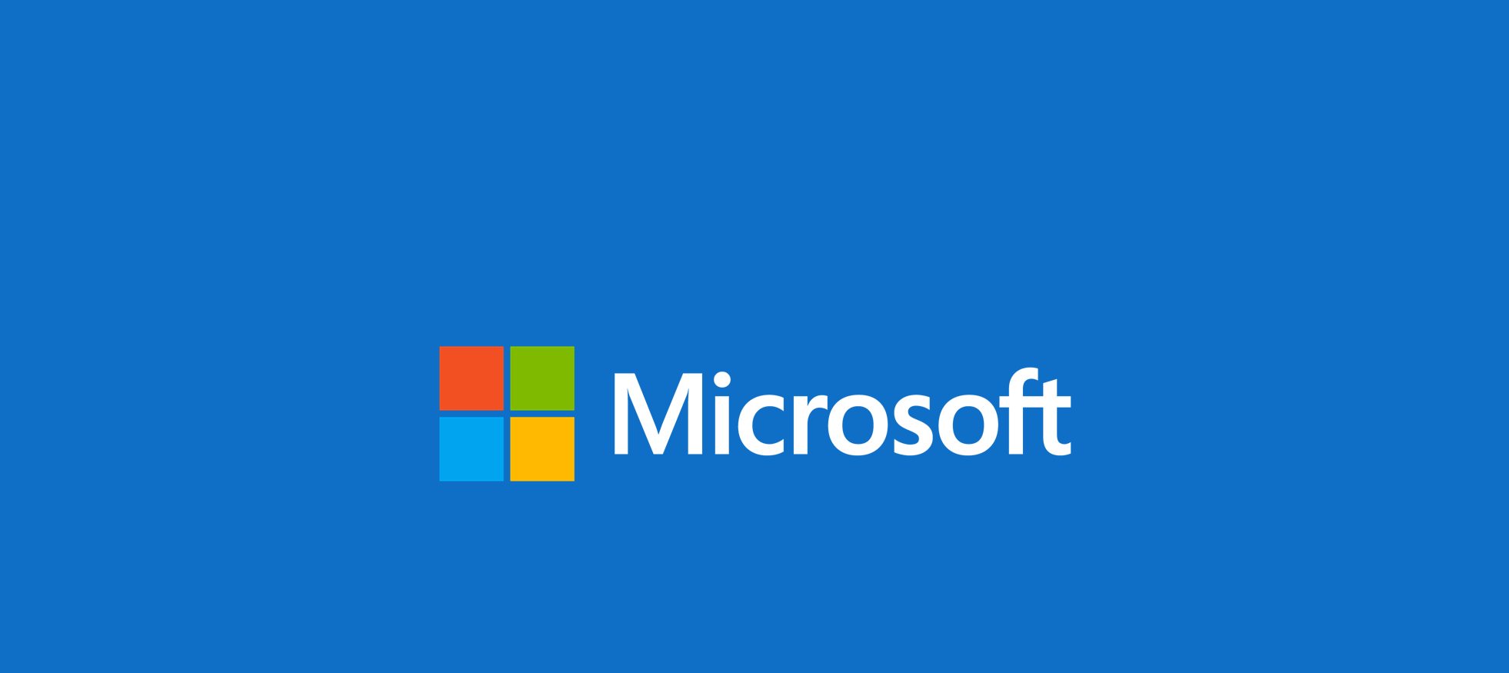

© 2014 Microsoft Corporation. All rights reserved. Microsoft, Windows, and other product names are or may be registered trademarks and/or trademarks in the U.S. and/or other countries. The information herein is for informational purposes only and represents the current view of Microsoft Corporation as of the date of this presentation. Because Microsoft must respond to changing market conditions, it should not be interpreted to be a commitment on the part of Microsoft, and Microsoft cannot guarantee the accuracy of any information provided after the date of this presentation. MICROSOFT MAKES NO WARRANTIES, EXPRESS, IMPLIED OR STATUTORY, AS TO THE INFORMATION IN THIS PRESENTATION.

Slide 28


1. Why SAP on Azure - for Dev/Test Non-Production Environment
Currently
Non-production environment (e.g. dev, test, sandbox, training) combined can be larger than production environment in its server resource and storage size
Non-production environment is not used all the time – can be turned off after testing and development finish – owning it as capital is not wise
At the same time dev/test environment needs to be prepared urgently when business need it
Needs
Rapid deployment of dev/test environment ?
Huge cost savings can be expected d by running only when needed and switching to pay-per-use model ?

Slide 29
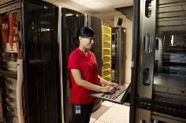
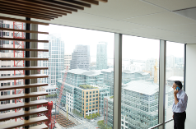
2. Why SAP on Azure - for DR “Half-”Production Environment
Currently
Cannot afford a big investment just for disaster recovery, although IT is increasingly asked to have one by CEO and COO
Not really reasonable to build highly available and secure datacenter(s) by customers by themselves just for disaster recovery
Needs
Cost savings through deploying disaster recovery environment on public cloud – adding necessary resource only when needed (e.g. in case of disaster) ?

Slide 30
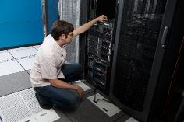

3. Why SAP on Azure - for Production Environment
Currently
Yes it is for production – but size is not large and doesn’t require extra high availability
Rapid deployment is priority
Don’t want to spend time to bring servers, set them up and configure
The environment is not busy all the time – busy only during specific periods
(e.g. fiscal month/year beginning or end)
Needs
Usually system resource is kept minimum - but can dynamically be added when needed
(e.g. Monthly batch job execution) – then reduce back when finished

Slide 31
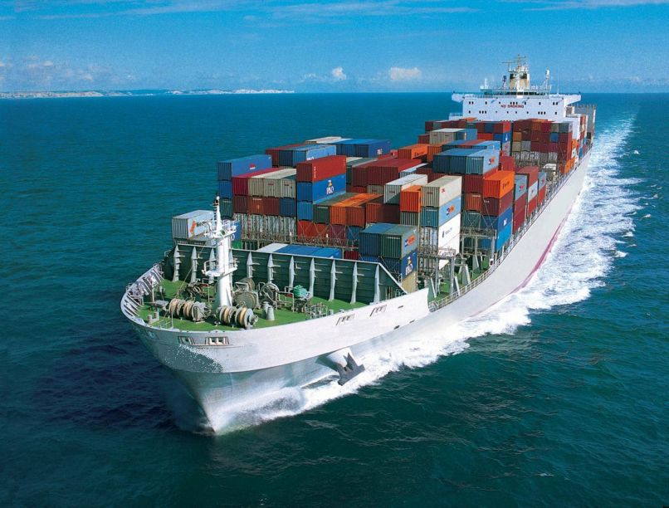


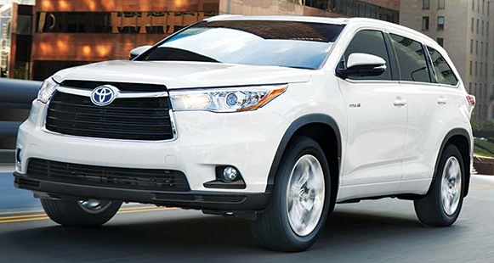
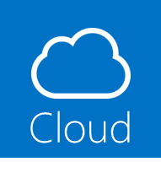
Japan’s Largest Trading Company Consolidated and Automated its Logistics/Finance Systems on Microsoft Cloud OS Platform
Business Situations
Logistics/Finance system’s agility, scalability and reliability were must not to slow down its business
IT had been unproductive due to lack of automation solutions while # of systems kept increasing
Disaster recovery solutions got urgent after M9 earthquake in Japan
Solutions
Switched from HP-UX/Oracle to Windows Server,
SQL Server with AlwaysOn,
Hyper-V with Live Migration
and Windows Azure IaaS
Promoted virtualization, consolidation, standardization and IT automation
Results
Repurposed 15 full time employees to more strategic positions thru automation
(out of 29 in total in the past)
40% TCO reductions
Zero RPO, 51-min RTO (in case of disaster)
“By using SQL Server 2012 AlwaysOn, we can instantly switch operations to a secondary server in the event of an earthquake or other disaster, allowing us to continue business operations no matter what.”
… Mr. Haruhiko Kuroda, Assistant Director, IT Promotions Division, Mitsui & Co., Ltd
Notes:
http://www.microsoft.com/casestudies/Microsoft-SQL-Server-2012/Mitsui-Co.-Ltd/Mitsui-Co.-Deploys-High-Availability-and-Disaster-Recovery-Solution-After-Earthquake/710000000584
http://www.microsoft.com/casestudies/Microsoft-SQL-Server-2008/Mitsui-Co.-LTD/Trading-Firm-Standardizes-on-IT-System-Running-in-Innovative-Private-Cloud/4000010234

Slide 32
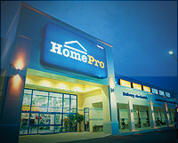



Thai Retailer Improves Performance and Availability of
Mission-Critical ERP and POS Data Management System
Business Situations
Retail business is very competitive in Thailand
56 stores across the country and more than 60k products
Uptime, performance, low cost of ownership and easy admin were all mandatory to serve their customers
Solutions
Shut down its previous SAP
IS-Retail solution on UNIX/Oracle and migrated to SQL Server 2008 R2 running on clustered Hyper-V
Windows Server securely deployed
Compression, column store index and partitioning up and running
Log shipping to DR site
Results
Performance and scalability, while cutting costs
HomePro can ease expansion in Thailand and Southeast Asia,
be more competitive, and ensure the continuous availability of its SAP system
“High availability is very important to us. Our ERP system supports mission-critical activities, and downtime is not an option. Without it, we can’t serve our customers.” … Surachate Tubtimjaroon, Vice President of Technical Service and Client Service at HomePro.
“In the past, we faced a growing volume of data and slower performance. But with SQL Server 2008 R2’s database compression, we can save disk space and improve the performance of our SAP environment.” … Wiroon Unggurarat, Manager of Information Communication Technology at HomePro
Notes:
http://www.microsoft.com/casestudies/Microsoft-SQL-Server-2008-R2-Enterprise/Home-Center-Public-Company-HomePro/Thai-Retailer-Improves-Performance-and-Availability-of-Mission-Critical-ERP-System/710000003235
HomePro relies on the SAP IS-RETAIL solution for core business operations using multiple modules such as ERP Central Component 6.0 EhP 5, Business Warehouse 7.30, POS Data Management, and Enterprise Portal.

Slide 33
Microsoft & SAP Solution for Manufacturing
Real Time Reporting of SAP MII with Office 365

Slide 34

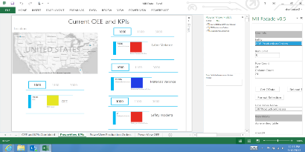
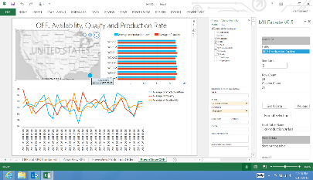
Microsoft & SAP alliance on Manufacturing
Lower TCO
Faster Decisions
SAP NEWSBYTE — June, 2013 — SAP AG (NYSE: SAP) today announced it is working with Microsoft Corp. to develop the first real-time incorporation of shop floor information using SAP MII and Microsoft Office 365, bringing greater manufacturing visibility to the flexible Microsoft Office solutions.
Speed of Data
Notes:
Lower TCO for EMI - Enabling additional self-service and ad-hoc capabilities that will provide visibility to live manufacturing data to more people
Accurate Decision Making - Faster decisions made on common data feeds and sources
Local Data from Local Reports from Local Systems - Ensures speed of the data and live access to it as well

Slide 35
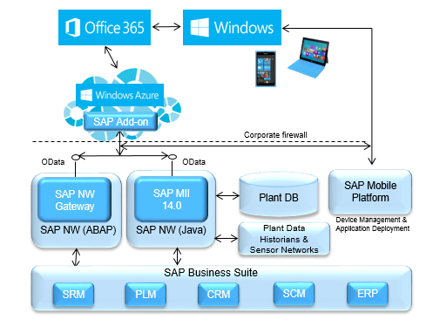
Office 365 Integration with SAP MII
Adhoc Reporting
Self-service BI
Collaboration
Consistent Data Visualization

Slide 36
PowerView Demo

Slide 37
Solution Overview

Slide 38
Solution Demo

Slide 39
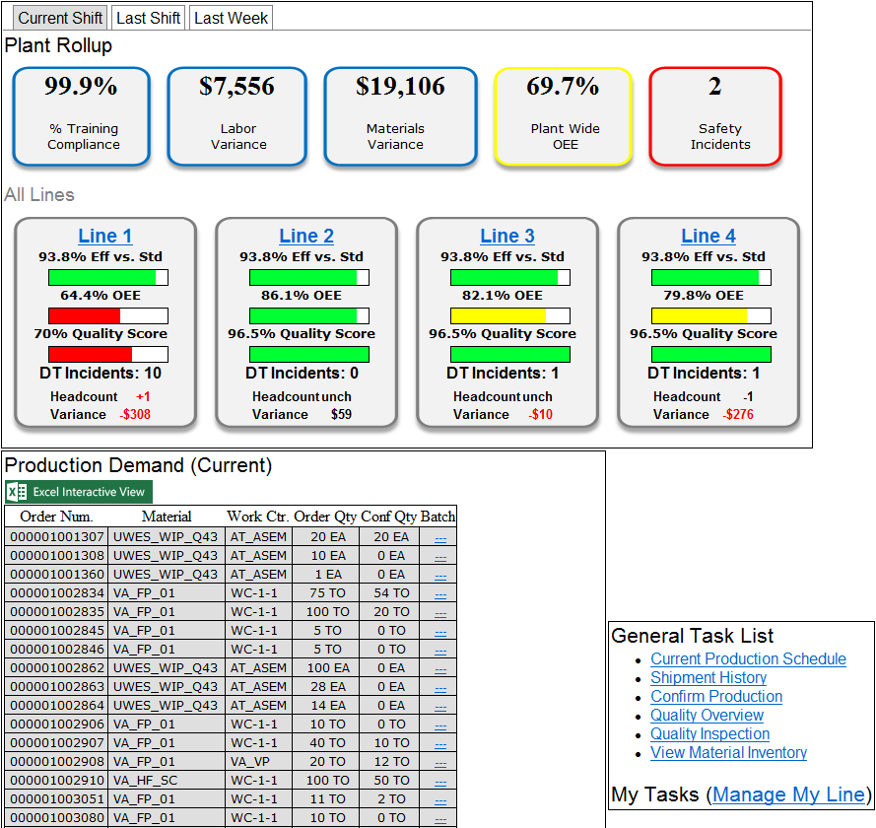
Demo Screen Shots – MII Production Cockpit

Slide 40
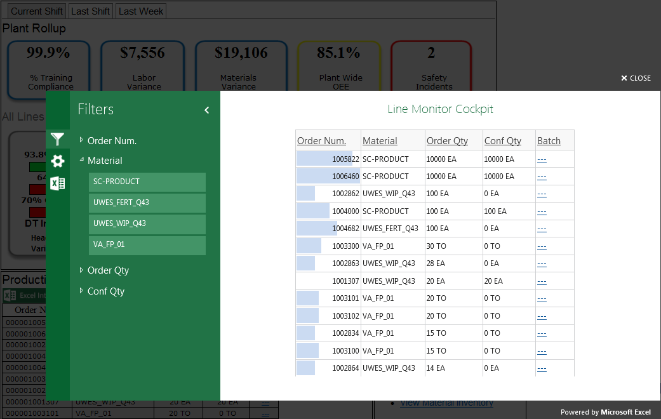
Demo Screen Shots – MII Production Cockpit

Slide 41
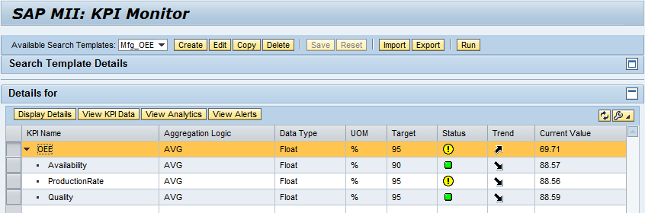
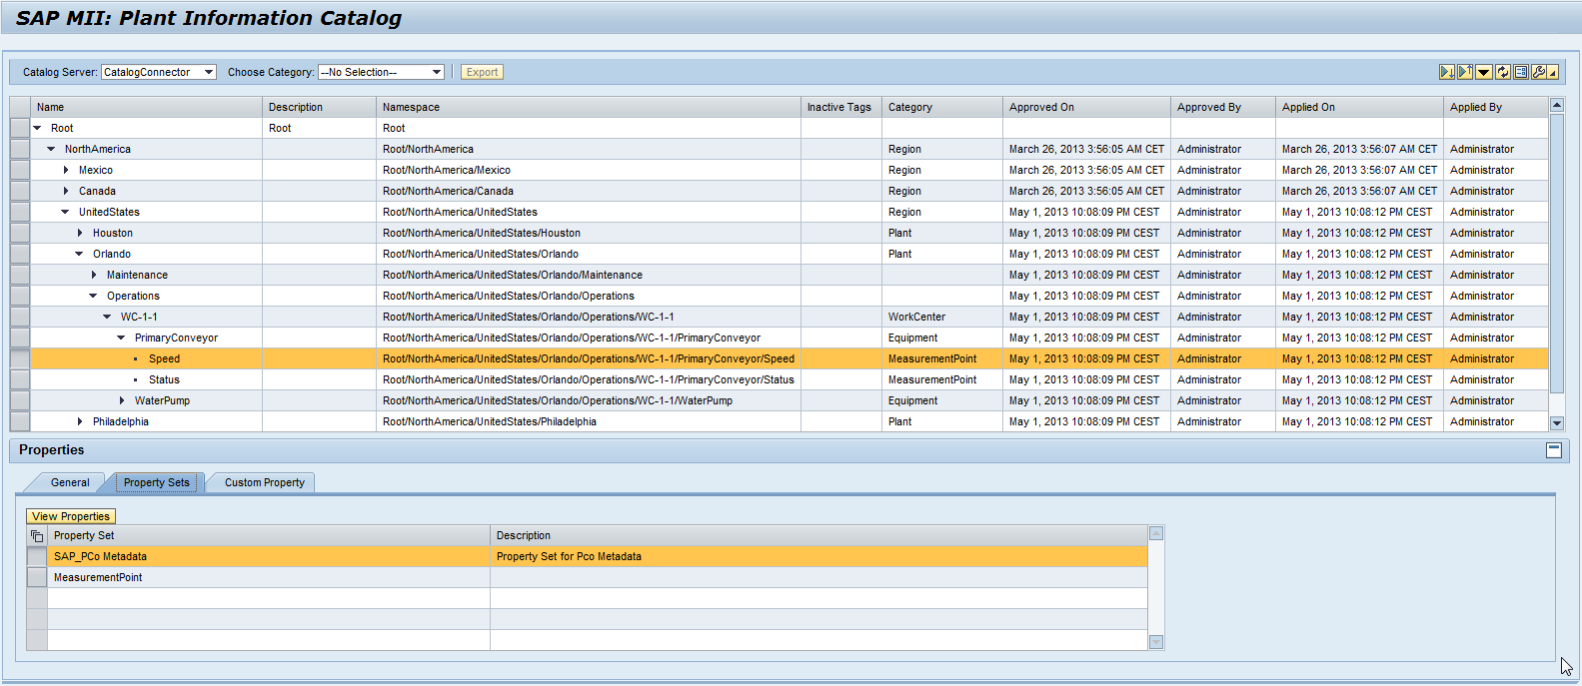
Demo Screen Shots KPI Framework & Plant Info Catalog

Slide 42

Demo Screen Shots MS O365 Power View

Slide 43
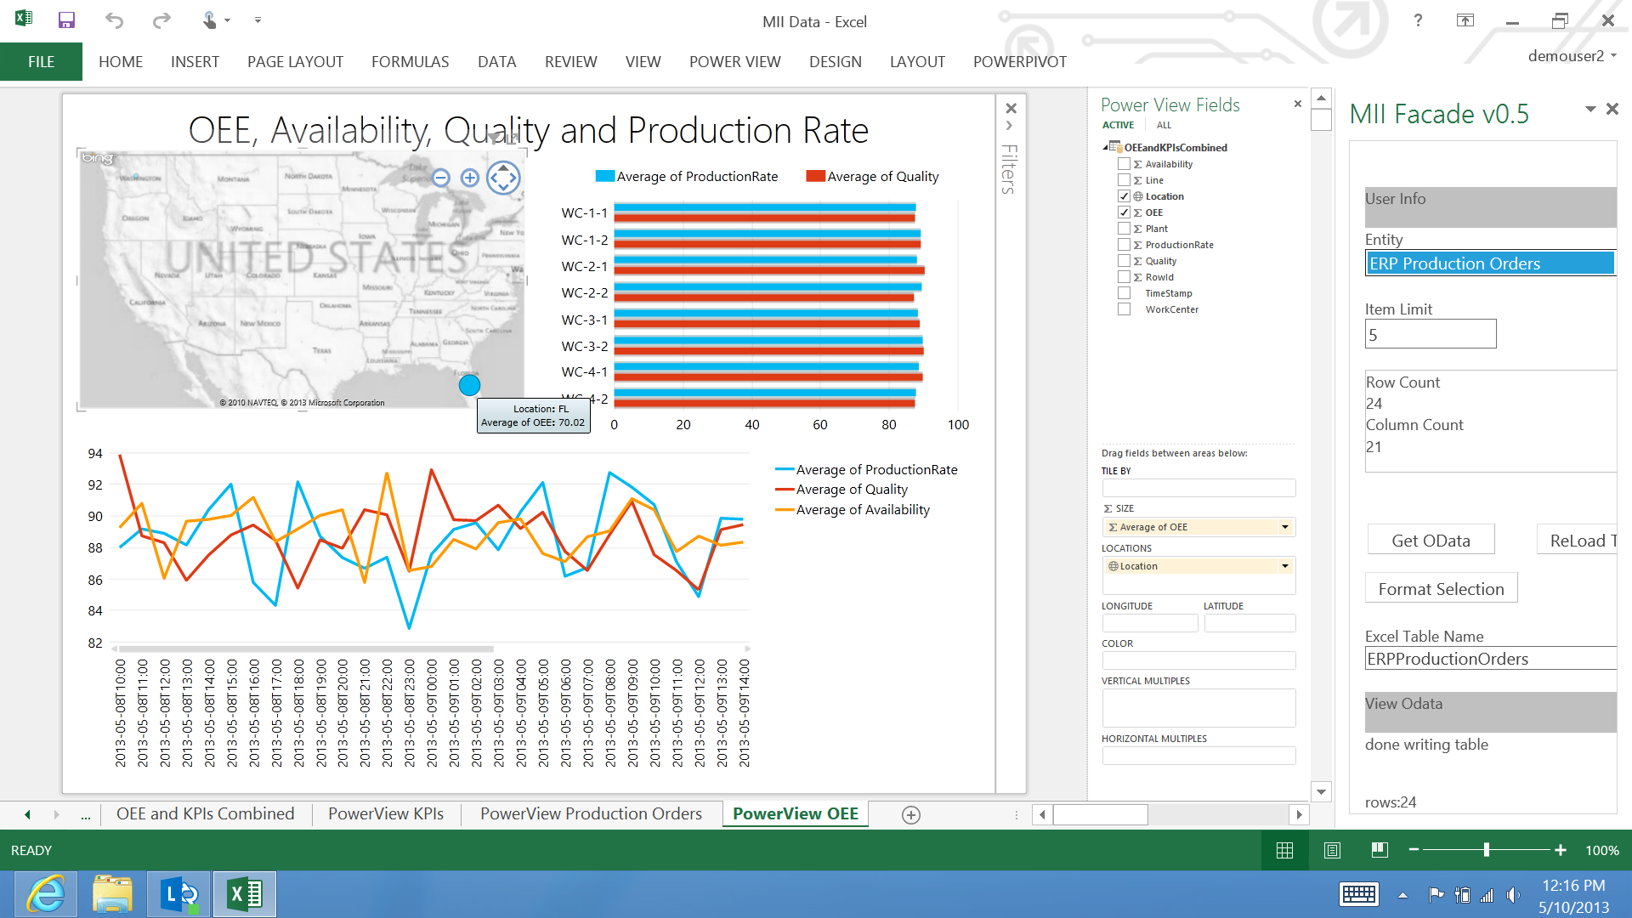
Demo Screen Shots MS O365 Power View

Slide 44
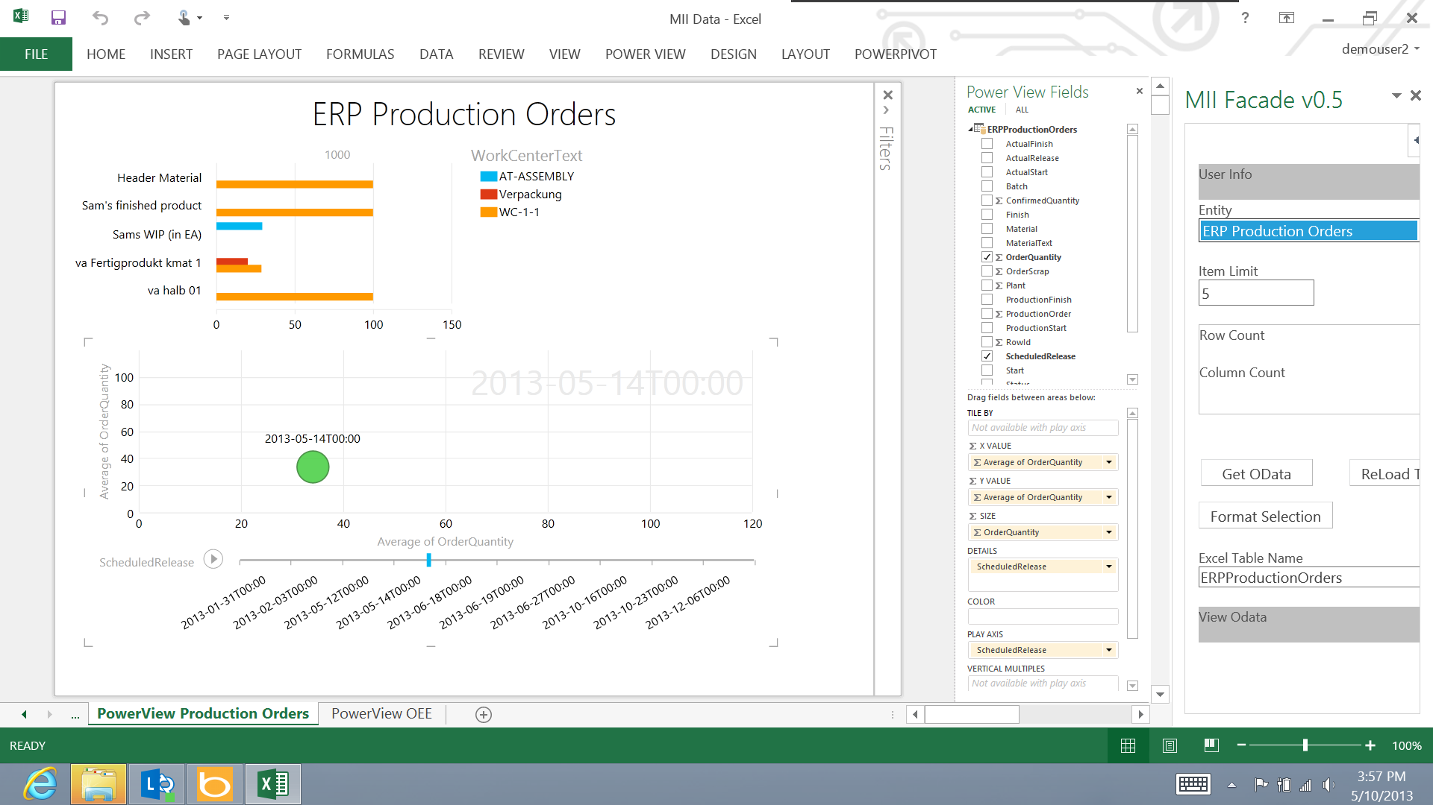
Demo Screen Shots MS O365 Power View

Slide 45
© 2014 Microsoft Corporation. All rights reserved. Microsoft, Windows, and other product names are or may be registered trademarks and/or trademarks in the U.S. and/or other countries. The information herein is for informational purposes only and represents the current view of Microsoft Corporation as of the date of this presentation. Because Microsoft must respond to changing market conditions, it should not be interpreted to be a commitment on the part of Microsoft, and Microsoft cannot guarantee the accuracy of any information provided after the date of this presentation. MICROSOFT MAKES NO WARRANTIES, EXPRESS, IMPLIED OR STATUTORY, AS TO THE INFORMATION IN THIS PRESENTATION.

