Slide 1
Oracle on Windows Azure
Parikshit Savjani
Sr. Premier Field Engineer, Microsoft

Slide 2
Agenda
Microsoft-Oracle Partnership Overview
Oracle On Azure
Licensing & Pricing
Provisioning Pre-configured Oracle Images on Azure
Deploying & Configuring Oracle Database on Azure VMs
Considerations
Case-Study Real-time BI
Oracle as OLTP and MS BI as a OLAP / Visualization Platform on Azure
Q & A
References

Slide 3
Microsoft – Oracle Partnership
Overview

Slide 4
Microsoft – Oracle Partnership Overview
To provide customers with private and public cloud platforms that enable the hybrid deployment strategies customers need.
Give customers more choice and flexibility to deploy Oracle software and therefore enables increased usage of Oracle software.
This partnership will help customers embrace cloud computing by providing greater choice and flexibility in how to deploy Oracle software.
Notes:
References
========
http://www.microsoft.com/en-us/news/press/2013/jun13/06-24wsnewspr.aspx
https://blogs.oracle.com/cloud/entry/oracle_and_microsoft_join_forces

Slide 5
Microsoft – Oracle Partnership Key Elements
Full support for Oracle software on Windows Server 2012 and
Windows Azure
Pay-as-you-go Azure images Of Oracle DB, WebLogic Server, JDK
Oracle license mobility for Azure public cloud
Fully licensed and supported
Java on Windows Azure
Oracle Linux available as preconfigured instances on Windows Azure

Slide 6
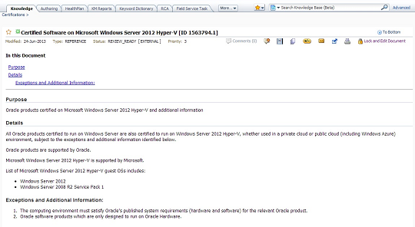
All Oracle software certified on Win2K12 Hyper-V runs on Azure!
Including:
JAVA 6 and JAVA 7
Oracle Fusion Middleware
Oracle Database
Oracle Linux
Note: Refer MOS Note 1563794.1 Certified Software on Microsoft Windows Server 2012 Hyper-V
Source: http://www.oracle.com/technetwork/topics/cloud/faq-1963009.html

Slide 7
Oracle on Azure (IaaS)

Slide 8
Licensing & Pricing
Bring Your Own License
Re-use existing or new licenses to run Oracle software on Azure
Oracle software licensing governed by Oracle Cloud Licensing policy
Azure IaaS costs governed separately by Azure pricing policy
Technical support for Oracle software provided by Oracle and Azure provided by Microsoft
Pay-as-you-go Plans
Pre-configured Images of select Oracle software available as Azure images available on a subscription basis
Oracle software subscription costs included within Azure IaaS pricing
Technical support for Oracle software available via via Windows Azure Support plan
Notes:
http://www.oracle.com/us/corporate/pricing/cloud-licensing-070579.pdf
http://www.windowsazure.com/en-us/pricing/details/virtual-machines/#oracle-software

Slide 9
Preconfigured Oracle – Images Ready for Provision
Software | Version | Edition | Operating System
Oracle Database | 12c | Enterprise / Standard | Windows Server 2012
 | 11gR2 |  | Windows Server 2008R2
Oracle WebLogic Server | 12c |  | Windows Server 2012
 | 11g |  | Windows Server 2008R2
Oracle Database and Weblogic Server | 12c |  | Windows Server 2012
 | 11g |  | Windows Server 2008R2
JAVA | JDK7 | - | Windows Server 2012
 | JDK6 |  | Windows Server 2008R2
Source: http://msdn.microsoft.com/en-us/library/dn439771.aspx

Slide 10
Demo - I
Provisioning an Oracle (Pre Built) Image on Azure

Slide 11
Configuring Oracle Database on the Azure Pre-Built Image

Slide 12
Configuring Oracle Database on the Provisioned Azure Images
Create Database
Run DBCA
Set ORACLE_HOSTNAME
Use OUI to verify Installed Products
Configure Remote Access
Configure Listener using Netca
Open Windows Firewall port for Listener port
Create Public Endpoint for Listener
Create Public Endpoint for Enterprise Manager
Configure Enterprise Manager
Use SQLPlus to confirm database creation

Slide 13
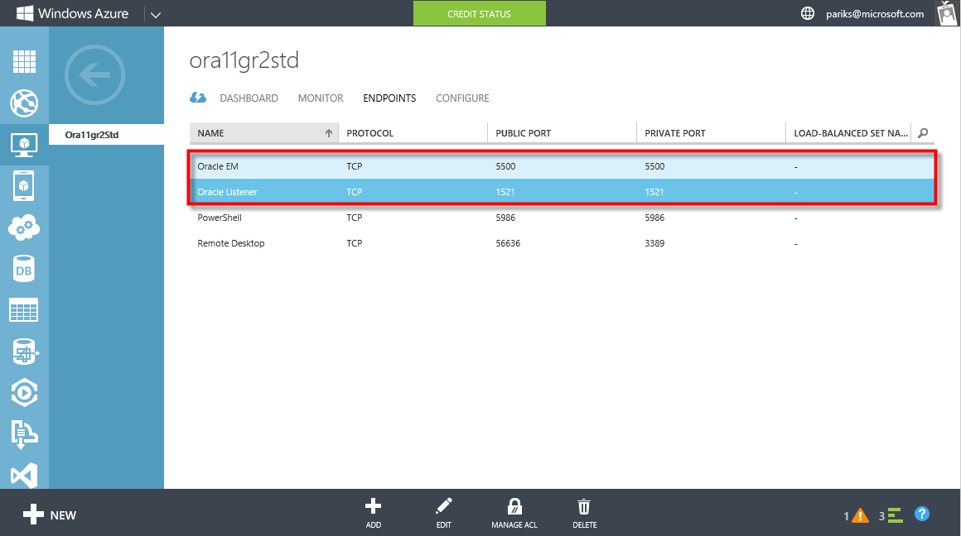
Configuring Oracle for Remote Access

Slide 14
Demo - II
Configuring Oracle Database on the Azure Pre Built Image

Slide 15
High Availability & Disaster Recovery Considerations for Oracle Database on Windows Azure
oracleonazure.cloudapp.net
Cloud Service
Static Private IP, private port
Static Private IP, private port
Oracle VM1
Oracle VM2
Fault Domain RACK
Availability Set
Fault Domain RACK
Notes:
When using Oracle Database in Windows Azure Virtual Machines, you are responsible for implementing a high availability and disaster recovery solution to avoid any downtime. You are also responsible for backing up your own data and application.
High availability and disaster recovery for Oracle Database Enterprise Edition (without RAC) on Windows Azure can be achieved using Oracle Active Data Guard or Oracle GoldenGate, with two databases in two separate virtual machines (VMs). Both virtual machines should be in the same cloud service and the same virtual network to ensure they can access each other over the private persistent IP address. Additionally, it is recommended to place the VMs in the same availability set to allow Windows Azure to place them into separate fault domains and upgrade domains. Note that only VMs in the same cloud service can participate in the same availability set. Each VM must have at least 2 GB of memory and 5 GB of disk space.
With Oracle Active Data Guard, high availability can be achieved with a primary database in one VM, a secondary (standby) database in another VM, and one-way replication set up between them. With Oracle GoldenGate, you can configure bi-directional replication between the two databases. To learn how to setup a high availability solution for your databases using these tools, see Active Data Guard and GoldenGate documentation at Oracle web site.

Slide 16
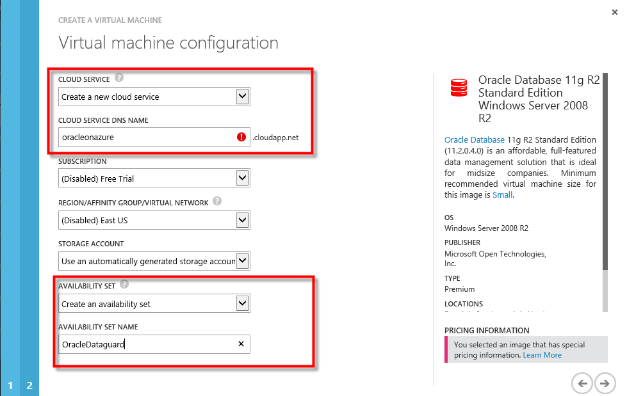
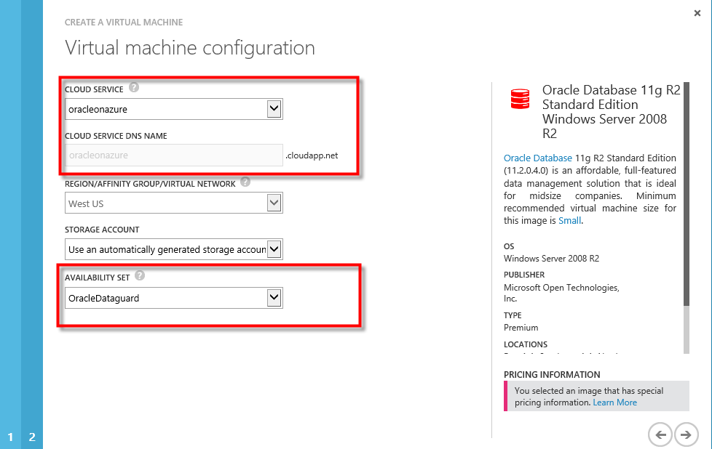
Configuring Cloud Service & Availability Set for Oracle DataGuard/Goldengate
VM1
VM2

Slide 17
Oracle on Azure Considerations
Clustering (RAC) is not supported
Configuring Oracle Data Guard for Windows Azure
Configuring Oracle Golden Gate for Windows Azure
No static IP
Attached disk configuration options
Oracle ASM on its own
Oracle ASM on Windows Server 2012 storage pools
Clustering supported in Web Logic Enterprise edition only
UDP multi-cast is not supported
Source: http://msdn.microsoft.com/en-us/library/dn439773.aspx

Slide 18
Case-Study Real-time BI – Oracle as OLTP and MS BI as a OLAP / Visualization Platform on Azure

Slide 19
CDC – Oracle OLTP to SQL DW Concept
Log Miner
SQL Server CDC Staging Database
ACTIVE Archive REDO Log File A_1
Oracle
1.
2.
SQL Server CDC Service
:
:
3.
4.
INACTIVE Archive REDO
Log File A_n
5.
CDC SSIS Package
SQL Server / DB 2 / Oracle / PDW
6.

Slide 20
CDC – Oracle to SQL - Architecture
Azure
SQL Server 2012
(Staging)
Oracle 12c
(OLTP)
2.
SQL Server CDC Service
1.
3.
SQL Server 2012
(DW)
SQL Server Agent
4.
SSAS 2012
(In-memory Tabular)
Power View
5.

Slide 21
Demo - III
Real-time BI – Oracle as OLTP and MS BI as a OLAP / Visualization Platform on Azure

Slide 22
Key Takeaways
All Oracle software certified on Win2K12 Hyper-V runs on Azure!
Customers can BYOL or use Pay-as-you-go Pre-Built Oracle Images on Azure
Create Endpoints to open Public ports for Remote Administration and Access
For Oracle Dataguard/GoldenGate configurations, the participating VMs should be part of same availability set, Cloud service & Virtual Network
Refer http://msdn.microsoft.com/en-us/library/dn439770.aspx for configuring Oracle Images on Azure

Slide 23
References
Microsoft – Oracle Partnership Overview
http://www.microsoft.com/en-us/news/press/2013/jun13/06-24wsnewspr.aspx
https://blogs.oracle.com/cloud/entry/oracle_and_microsoft_join_forces
Oracle Support Policy for Windows Azure
http://www.oracle.com/technetwork/topics/cloud/faq-1963009.html
http://www.oracle.com/us/corporate/pricing/cloud-licensing-070579.pdf (Bring Your Own License)
Microsoft Pricing & Support Policy for Oracle Pre-configured Images
http://www.windowsazure.com/en-us/pricing/details/virtual-machines/#oracle-software (Pay-as-you-go)
Considerations for Configuring & Deploying Oracle on Azure
http://msdn.microsoft.com/en-us/library/dn439770.aspx

Slide 24
Q & A

Slide 25
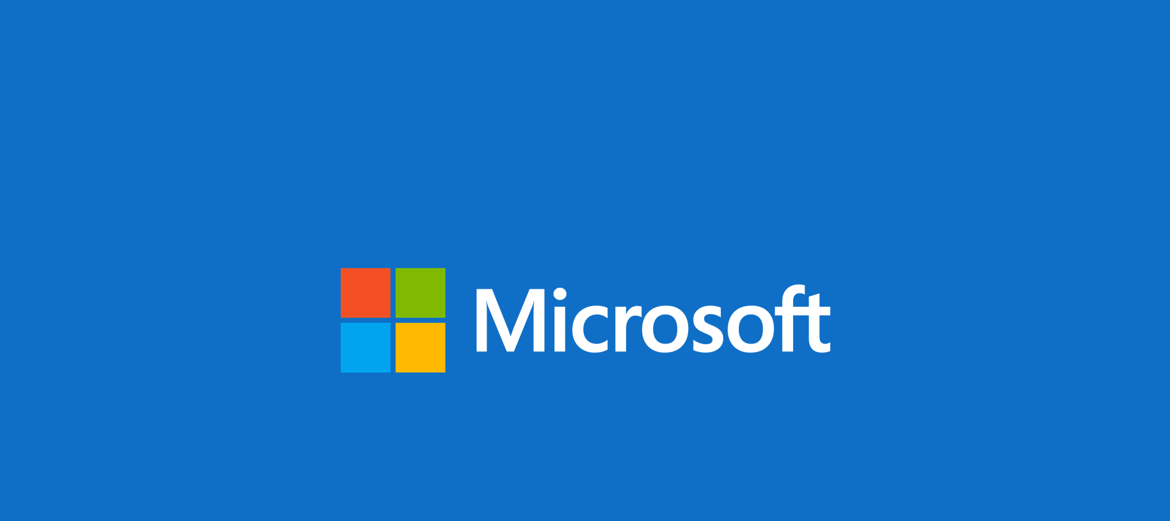
© 2014 Microsoft Corporation. All rights reserved. Microsoft, Windows, and other product names are or may be registered trademarks and/or trademarks in the U.S. and/or other countries. The information herein is for informational purposes only and represents the current view of Microsoft Corporation as of the date of this presentation. Because Microsoft must respond to changing market conditions, it should not be interpreted to be a commitment on the part of Microsoft, and Microsoft cannot guarantee the accuracy of any information provided after the date of this presentation. MICROSOFT MAKES NO WARRANTIES, EXPRESS, IMPLIED OR STATUTORY, AS TO THE INFORMATION IN THIS PRESENTATION.

